Slide 1
Performance of an Advanced Silicon Drift Detector with Ultra-Fast Pulse Processing
Shaul Barkan, Valeri D. Saveliev, Yen-Nai Wang, Mengyao Zhang, Liangyuan Feng, Elena V. Damron and Brian Goolsby

Slide 2
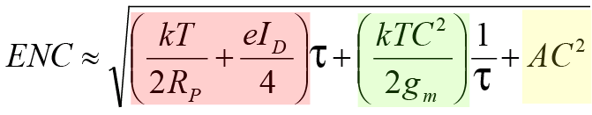
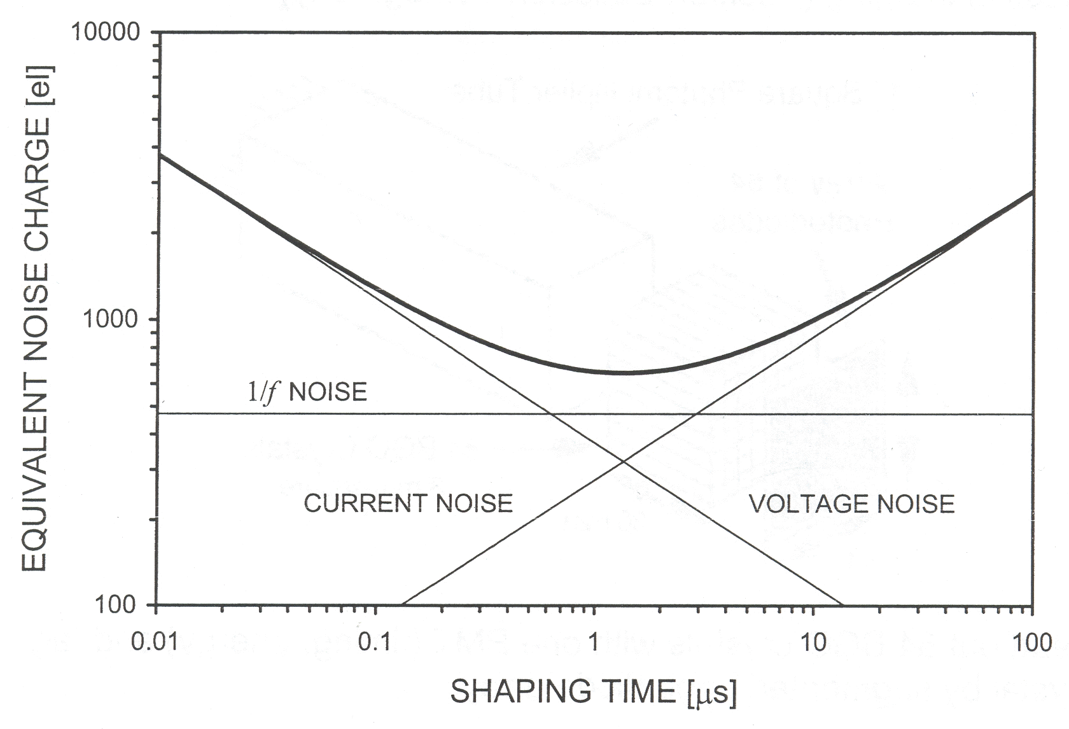
For charge preamplifier, ‘Equivalent Noise Charge’
(expressed in e⁻ r.m.s) analysis gives
parallel noise
series noise
1/f noise
τ is signal ‘shaping time’
total noise
‘parallel’
‘series’

Slide 3
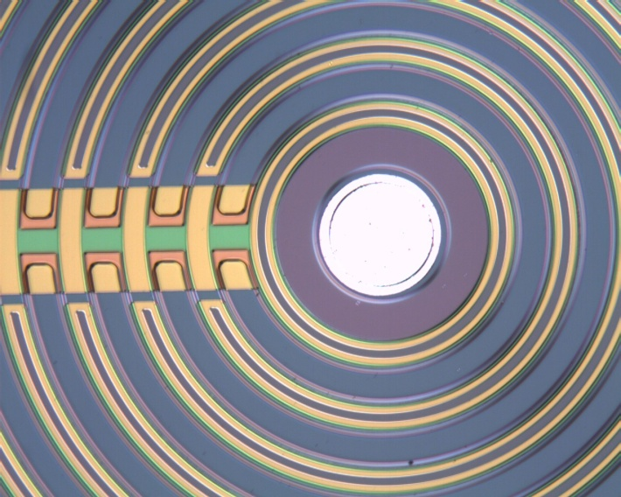
SDD – Cathodes side
Steering electrodes
R ladder
Anode
A small anode 80μm diameter, generates an SDD capacitance of 60fF
Notes:
A basic drift detector structure is constructed from a high resistivity silicon starting material that has reverse bias applied to electrodes on both the front and back of the device so that the bulk of the detector is fully depleted, producing a parabolic shaped potential valley within the detector from the front to the back side . The bottom of the potential valley corresponds to the minimum potential energy for electrons, and is where the electrons are transported. By then applying a radial potential gradient across the back surface of the detector (with potential increasing with the radius), the drift valley can be forced to tilt along the detector toward the collection anode. The detector structure thus focuses the electron collection to the small anode with the induced signal occurring predominantly between the anode and the adjacent focusing electrode.
The drift structure has a very small capacitance of less than 100 fempto farads. If one can preserve the low capacitance by either integrating the front end FET or by using low capacitance external FETs, this leads to low noise at very short optimal shaping times.
When the device is used as a direct detector such as for for x-rays, the drift time of the device is inconsequential for devices with area up to at least one square cm. This is because the charge corresponding to the individual x-ray interactions propagate independently from discrete locations to the anode, and are effectively shielded by the surrounding rings until they are in the vicinity of the anode at which time the pulses are formed. In this case the temporal broadening of the charge pulse is due mainly to diffusion of the migrating carriers which can be kept small enough to still use the optimal fast shaping times for the best signal to noise.
On the other hand, in the case where the drift detector is coupled to a scintillator and used as a photodetector, gamma ray interactions in the scintillator lead to light which is spread over the entire active area of the photodetector. Thus charges migrate from throughout the detector towards the anode, and it is necessary to wait for all of it to arrive before the whole signal is formed. In his case, the drift time of the detector should be on the same order as the scintillator decay constant. Longer decay time scintillators and larger area devices then must employ longer than optimum shaping time. However as you will see, very good results are still obtained.

Slide 4
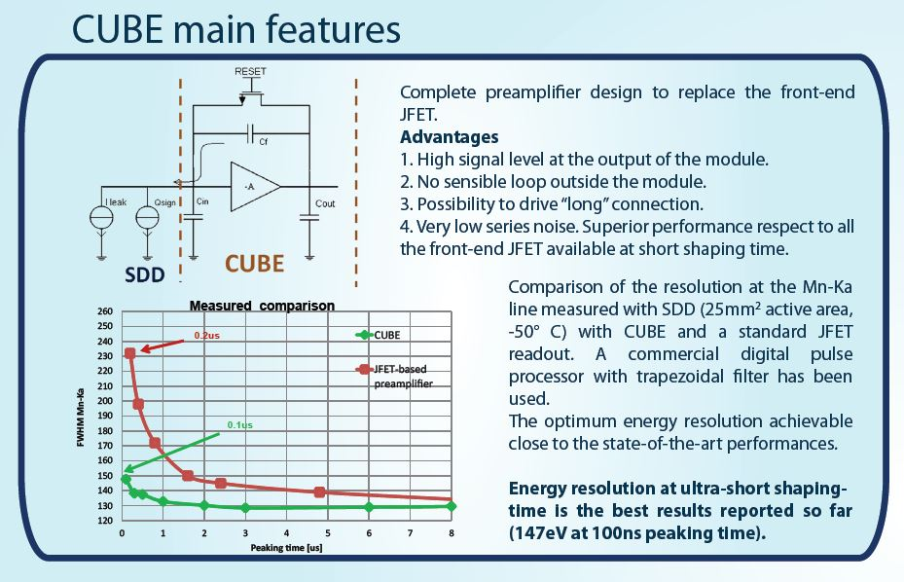
Recently the XGLab S.R.L. (Milan, Italy), introduced a new front-end electronics – the CUBE, which is a preamp using a MOSFET as a first amplification stage. The CUBE replaces the old version JFET and farther reduces the total input capacitance as well as increase the transconductance (gain). Hence it reduces the series and 1/f noise. As a result, the resolution is significantly improved at short processor’s peaking time.
Notes:
A basic drift detector structure is constructed from a high resistivity silicon starting material that has reverse bias applied to electrodes on both the front and back of the device so that the bulk of the detector is fully depleted, producing a parabolic shaped potential valley within the detector from the front to the back side . The bottom of the potential valley corresponds to the minimum potential energy for electrons, and is where the electrons are transported. By then applying a radial potential gradient across the back surface of the detector (with potential increasing with the radius), the drift valley can be forced to tilt along the detector toward the collection anode. The detector structure thus focuses the electron collection to the small anode with the induced signal occurring predominantly between the anode and the adjacent focusing electrode.
The drift structure has a very small capacitance of less than 100 fempto farads. If one can preserve the low capacitance by either integrating the front end FET or by using low capacitance external FETs, this leads to low noise at very short optimal shaping times.
When the device is used as a direct detector such as for for x-rays, the drift time of the device is inconsequential for devices with area up to at least one square cm. This is because the charge corresponding to the individual x-ray interactions propagate independently from discrete locations to the anode, and are effectively shielded by the surrounding rings until they are in the vicinity of the anode at which time the pulses are formed. In this case the temporal broadening of the charge pulse is due mainly to diffusion of the migrating carriers which can be kept small enough to still use the optimal fast shaping times for the best signal to noise.
On the other hand, in the case where the drift detector is coupled to a scintillator and used as a photodetector, gamma ray interactions in the scintillator lead to light which is spread over the entire active area of the photodetector. Thus charges migrate from throughout the detector towards the anode, and it is necessary to wait for all of it to arrive before the whole signal is formed. In his case, the drift time of the detector should be on the same order as the scintillator decay constant. Longer decay time scintillators and larger area devices then must employ longer than optimum shaping time. However as you will see, very good results are still obtained.

Slide 6
Low energy performance of the Vortex® SDD (a BN sample)

Slide 7
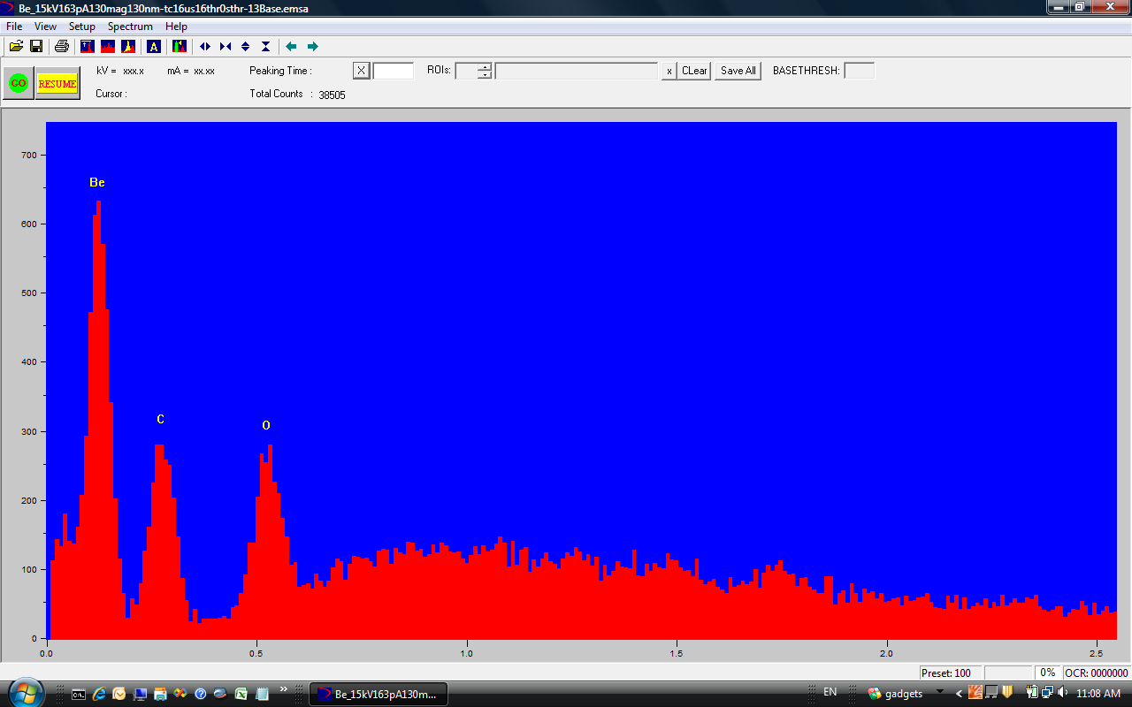
Be sample spectrum (Be K_{α} 110 eV)

Slide 8
Vortex® Models for Synchrotron Applications
Other than all single elements models
HHS-US Offers the following multi-element models:
ME3
ME4
ME5
ME7 (currently testing a prototype)
All models are tolerant to helium atmosphere!
We use IP with noble gases pumping capability

Slide 9
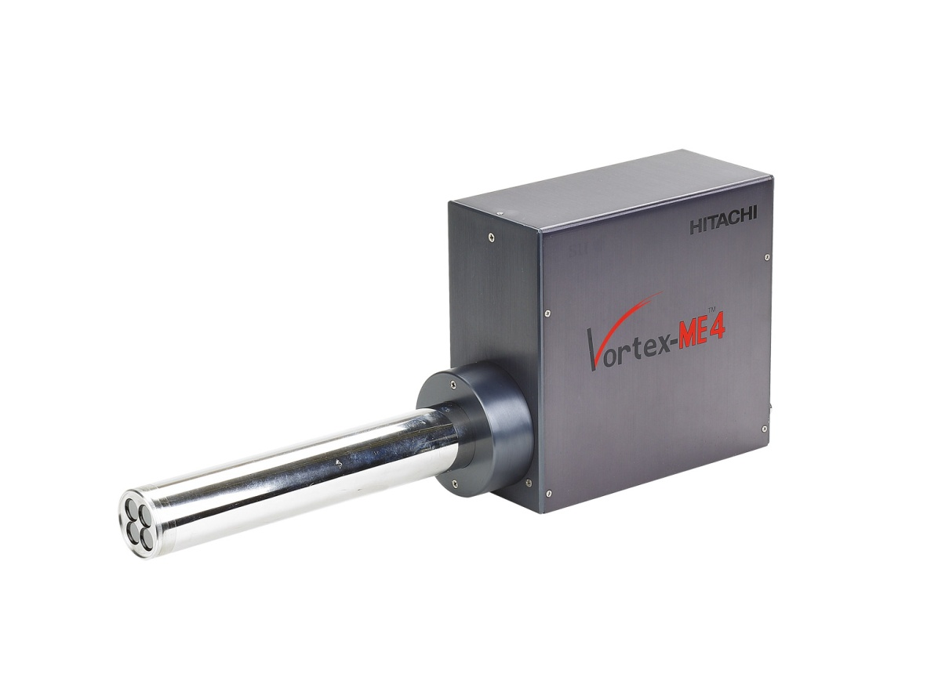
ME4 - Standard

Slide 10
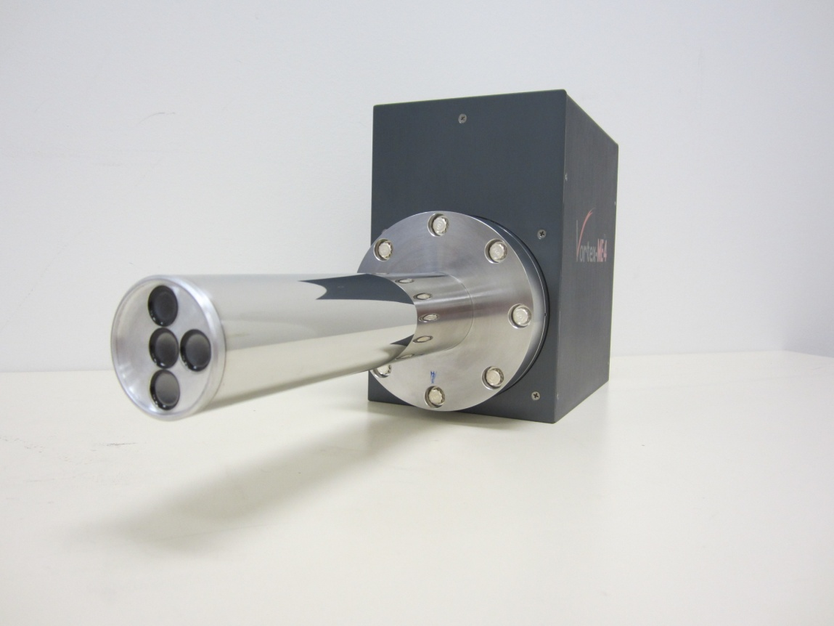
ME4 – “Offset”

Slide 11
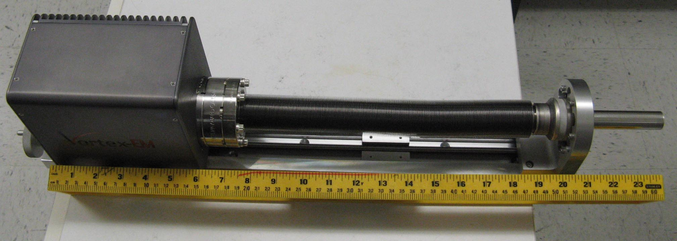
    EM 450 (APS, LBNL, DESY)
    Ultra-high vacuum interface
    Travel distance 260 mm
    with AP3.3 window for low energy applications

Slide 12
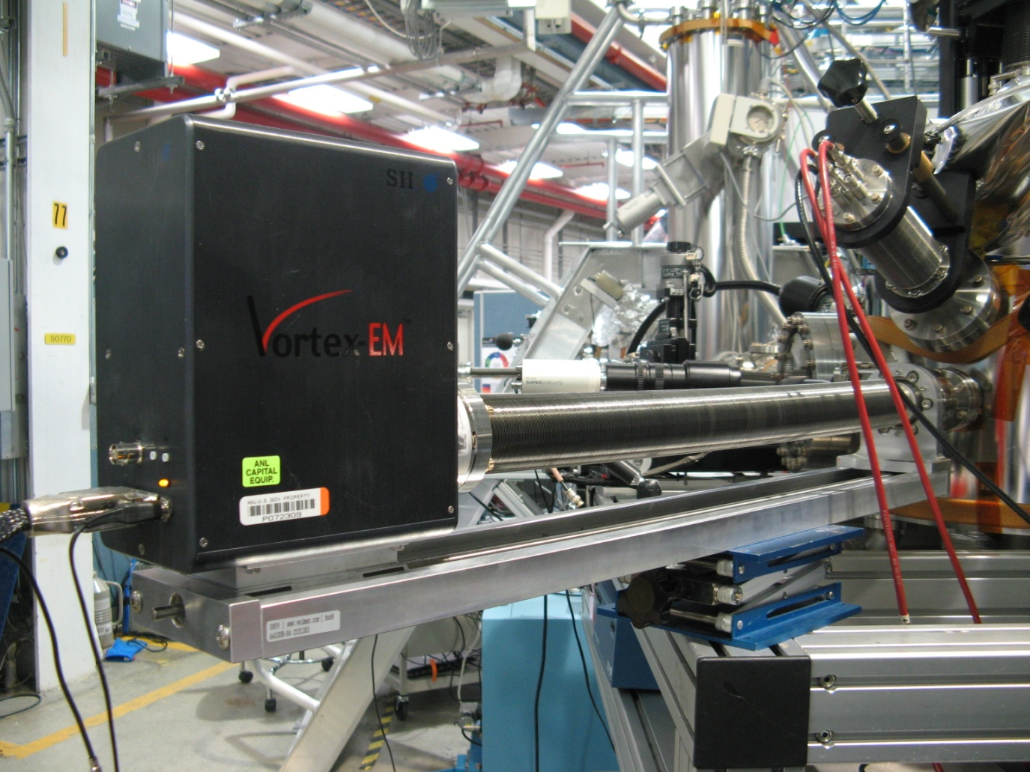
    EM600 at APS, ESRF, DLS, LBNL
    Ultra-high vacuum interface
    Travel distance 410 mm
    AP3.3 window for low energy applications

Slide 13
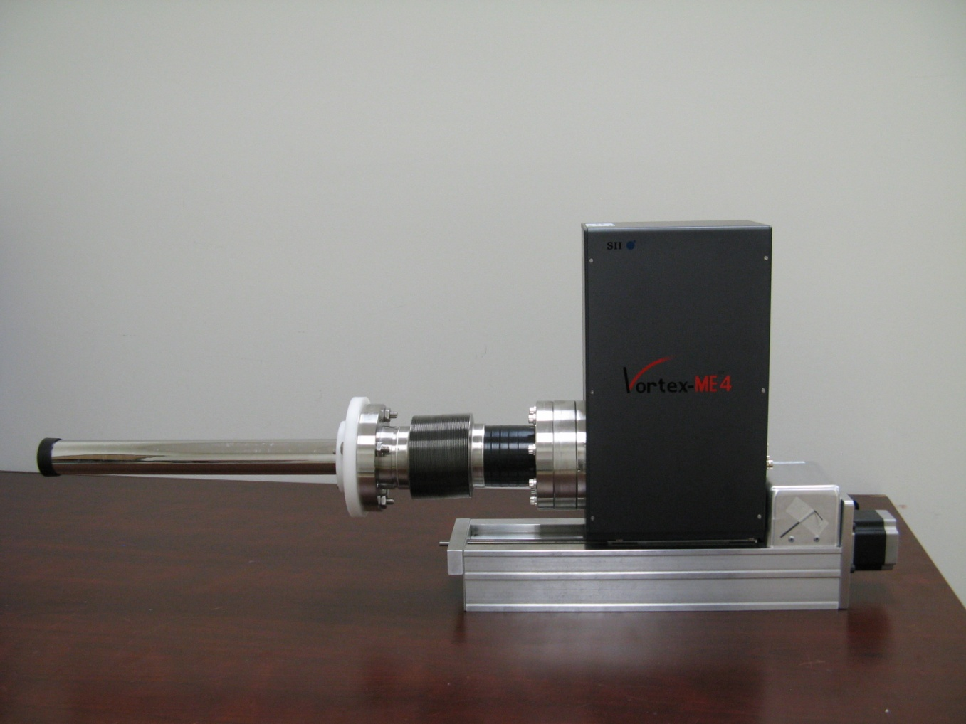
    ME4-550 (XRADIA)
    4-element, ultra-high vacuum interface
    Travel distance 280 mm
    Can be equipped with AP3.7 Mox window

Slide 14
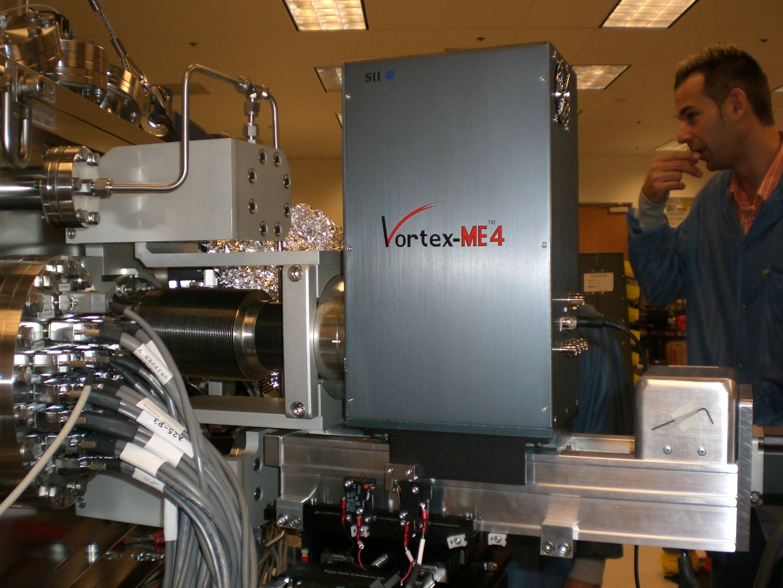
    ME4-550 (APS, ANKA, Xradia, LBNL)
    4-element, ultra-high vacuum interface
    Travel distance 280 mm

Slide 15
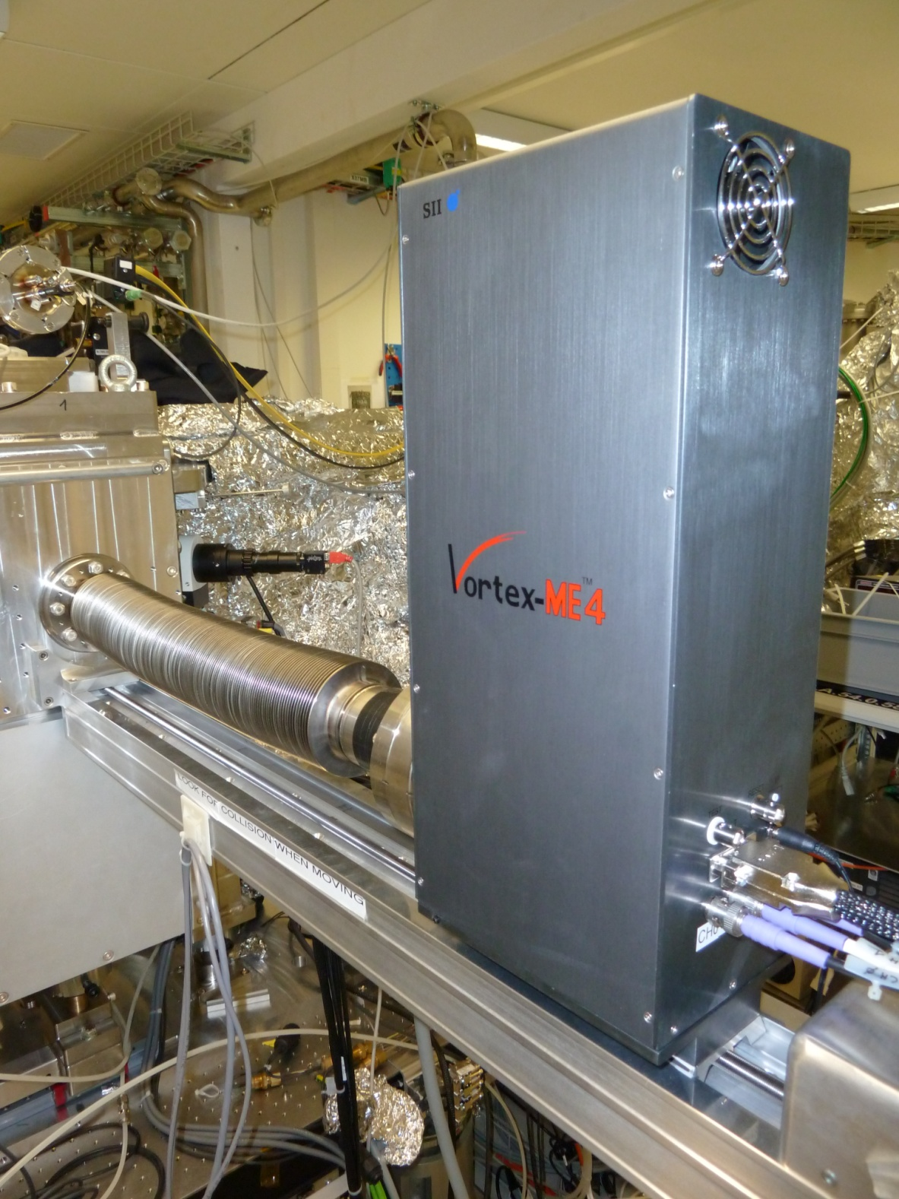
    ME4-750
    SLS, LSRI, NSRRC
    4-element
    ultra-high vacuum interface
    Travel distance 510 mm
    AP3.7 window

Slide 16
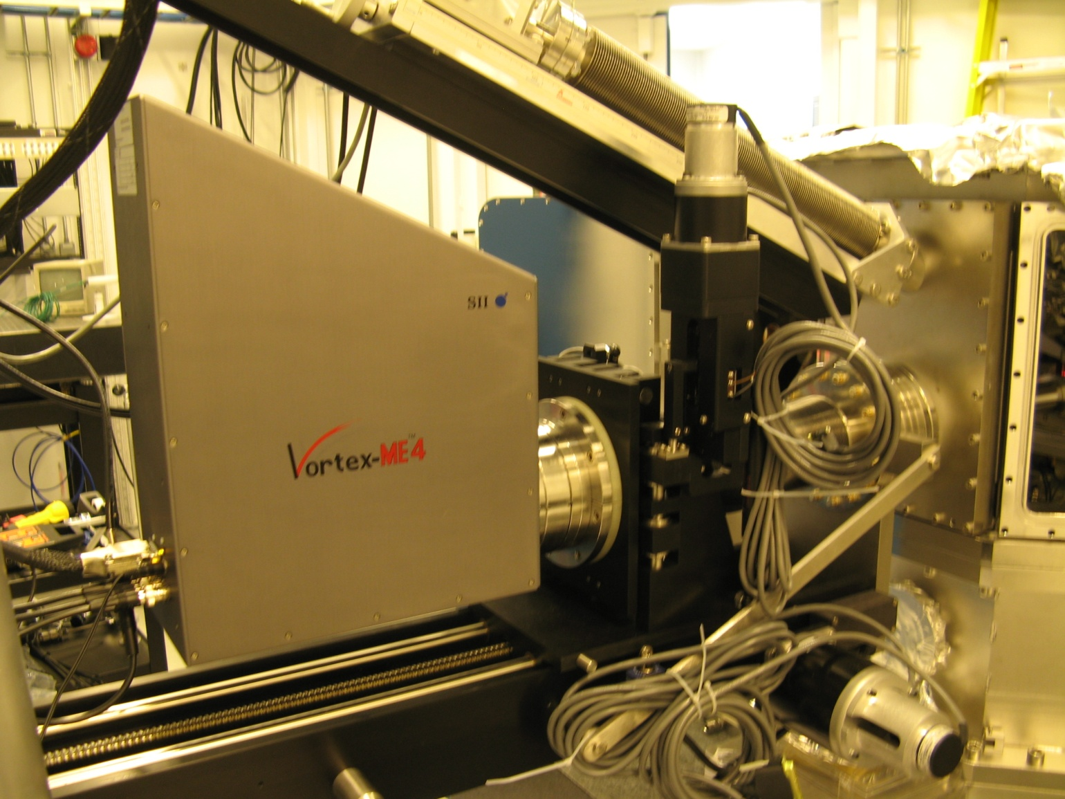
    ME4-800 at CNS and APS
    4-element, ultra-high vacuum interface
    Travel distance 590 mm

Slide 17
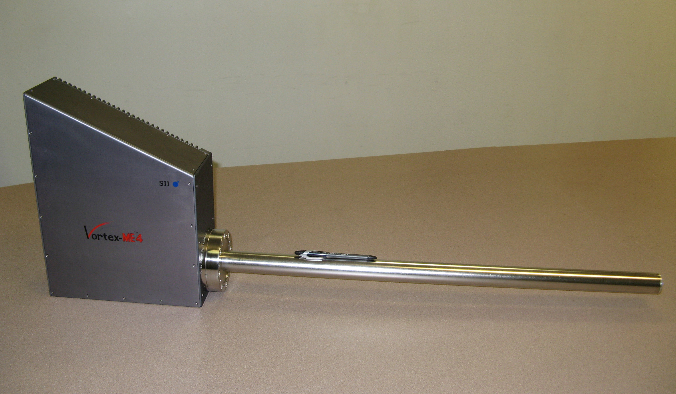
    ME4-800

Slide 18
Heat Pipe
United States Patent
Patent No. US 7,129,501 B2
Radiation Detector System Having Heat Pipe Based Cooling

Slide 19
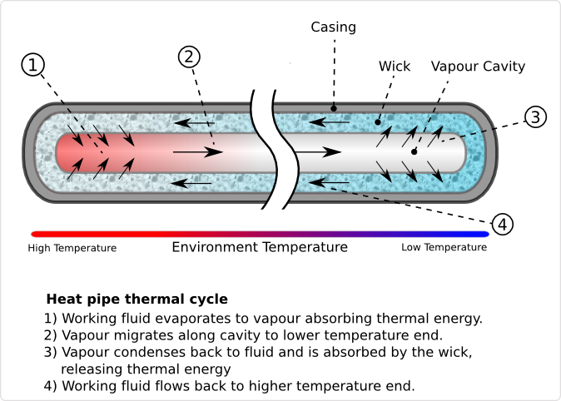
Heat Pipe diagram showing thermal cycle

Slide 20
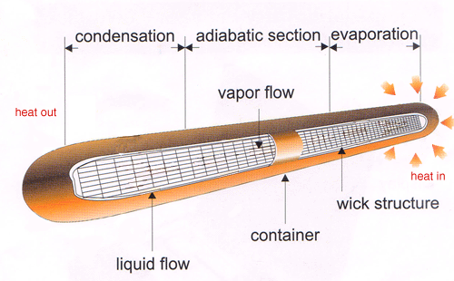

Slide 21
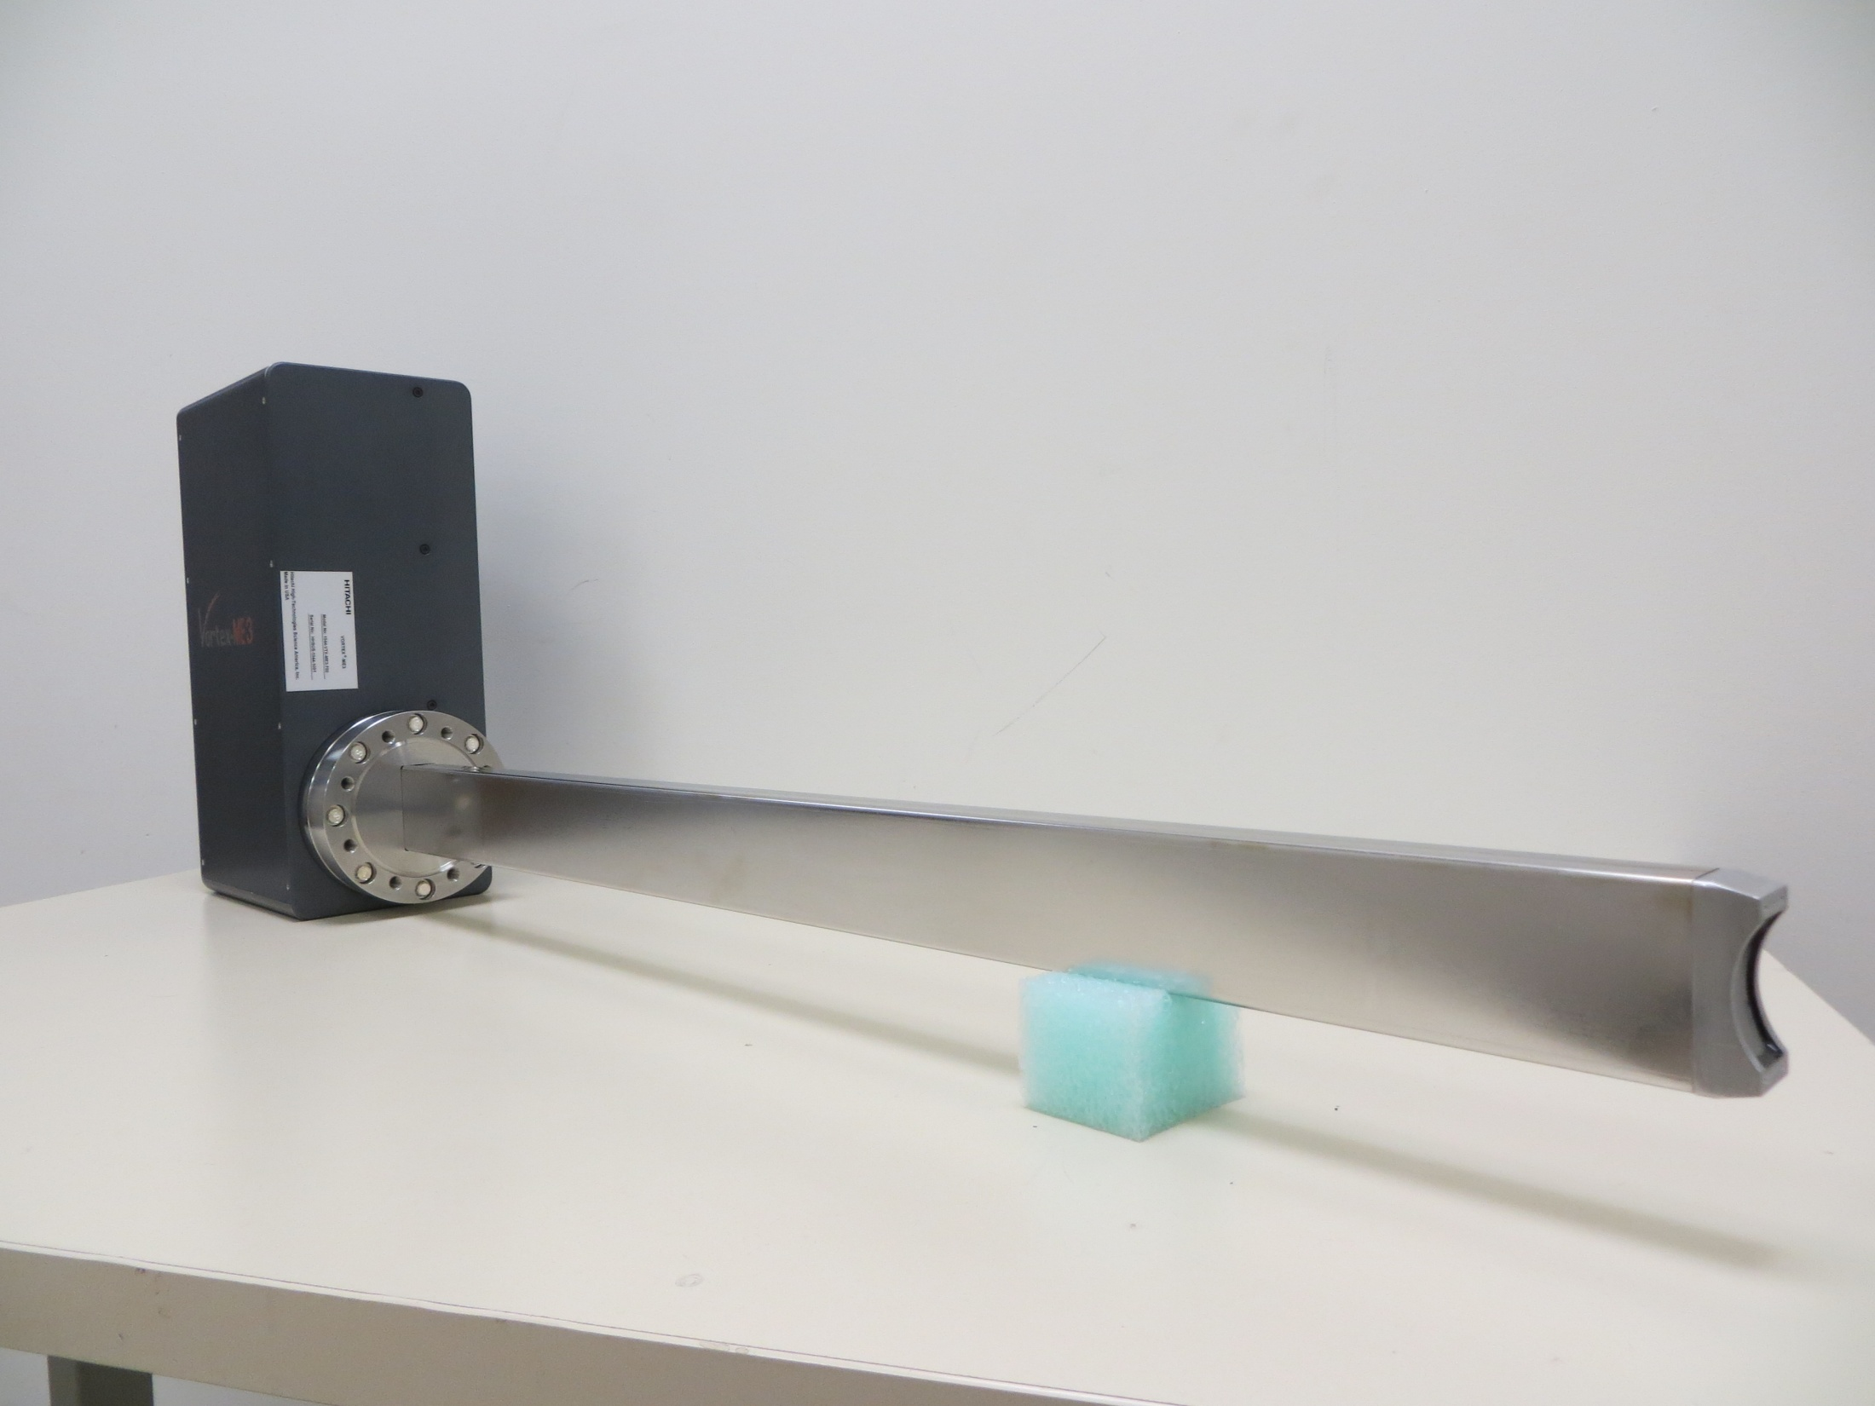
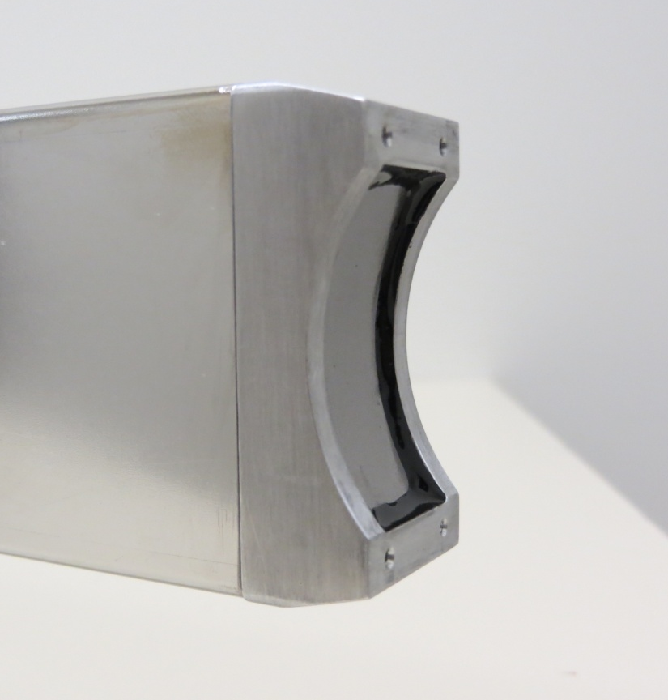
    ME3 – 3 element SDD “focal design” (NSLS II)

Slide 22
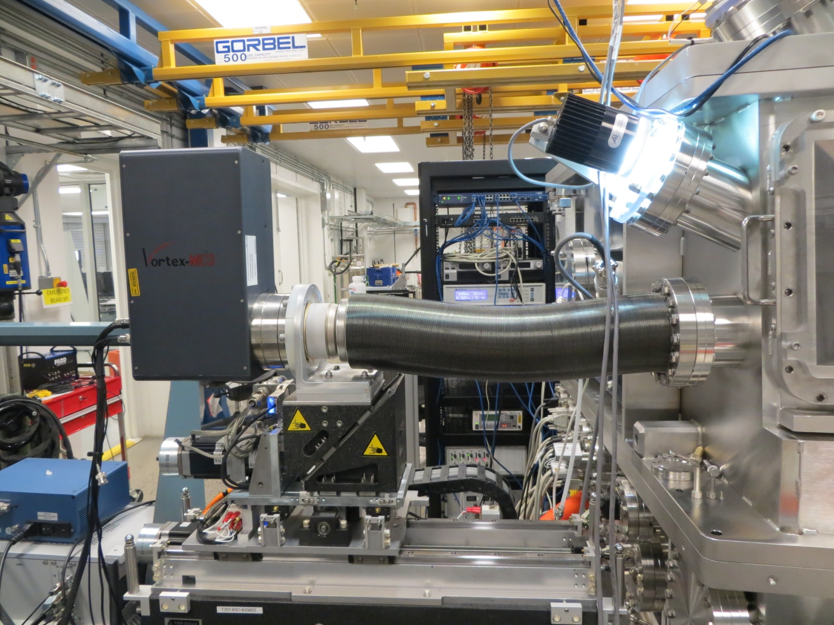
ME3, Focal Design at NSLS II

Slide 23
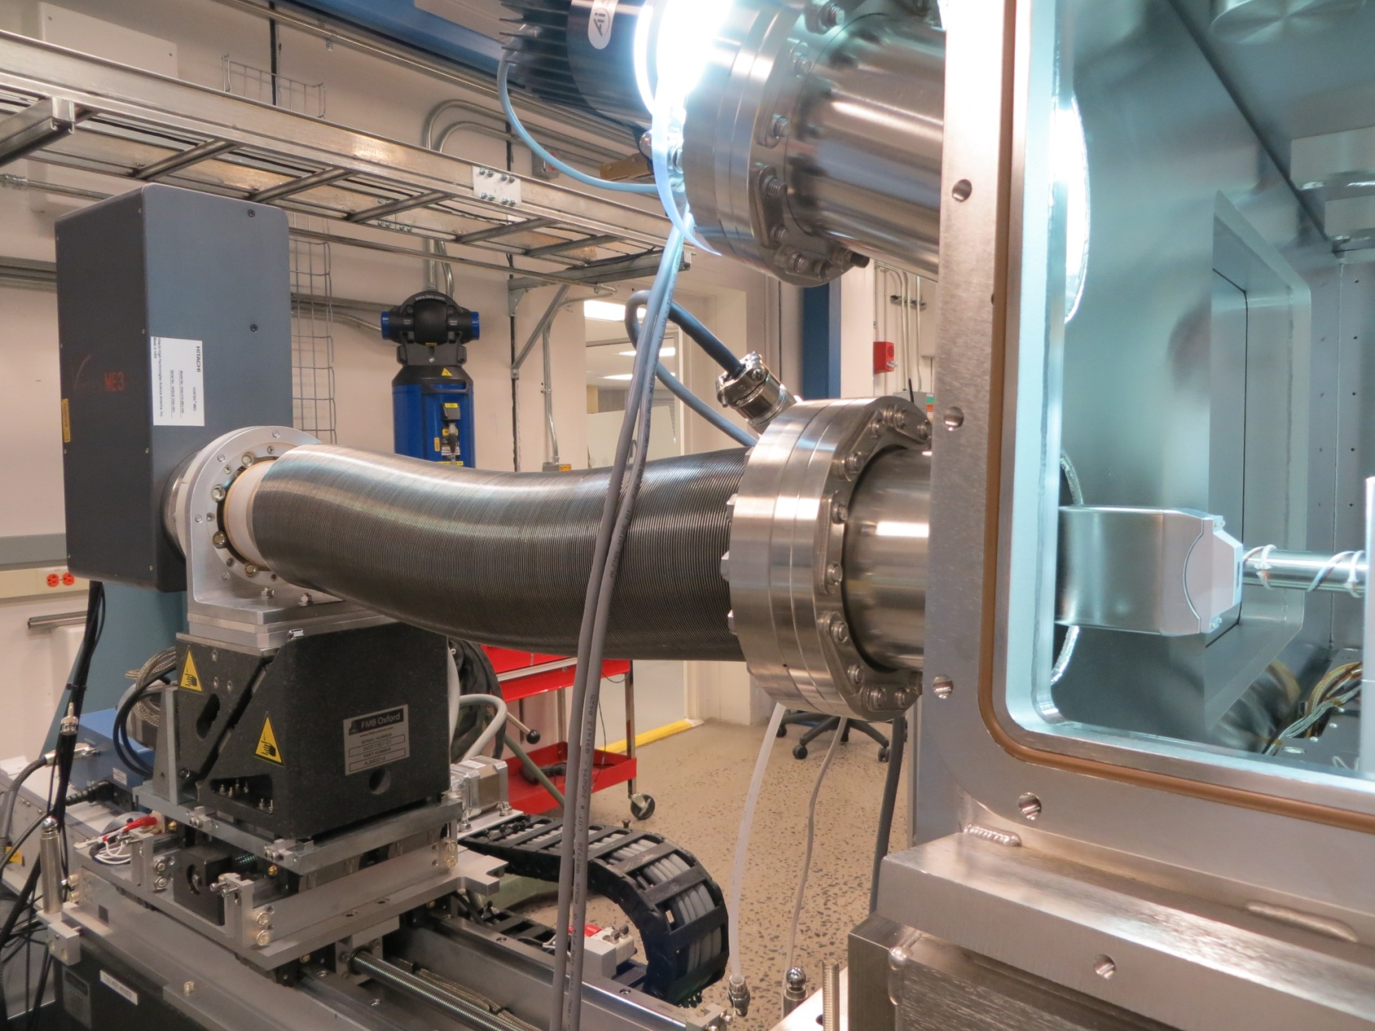
ME3, Focal Design at NSLS II

Slide 25
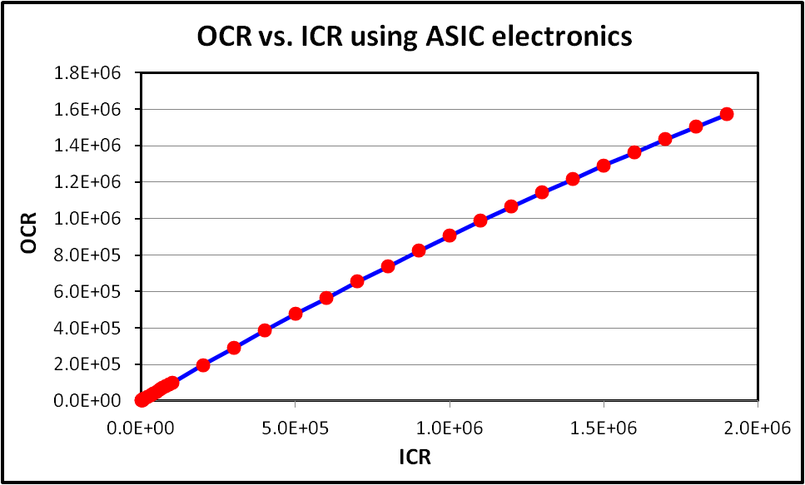
Super high count rate performance with single-element Vortex® SDD/ASIC device and the Xspress3 processor
DT=19%

Slide 26
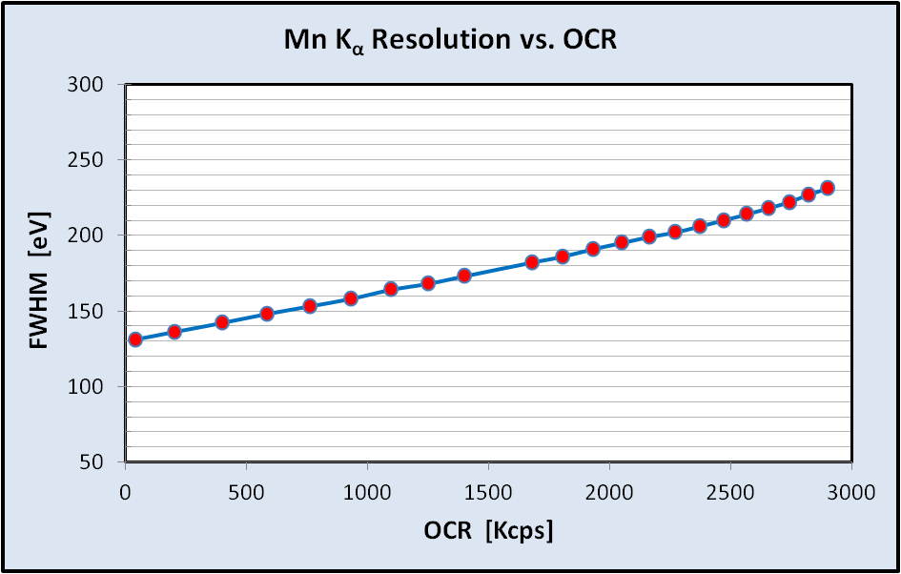
Resolution vs. Count Rate with single Vortex SDD/ASIC device
and the Xpress3 processor
The adaptive filter in the Xspress3 offers the best use of the data available from SDD. Instead of picking a shaping time and working with the results, the system effectively takes data at all shaping times from 12.5ns to 12.8µs and yields every bit of resolution in time and energy out of it.

Slide 27

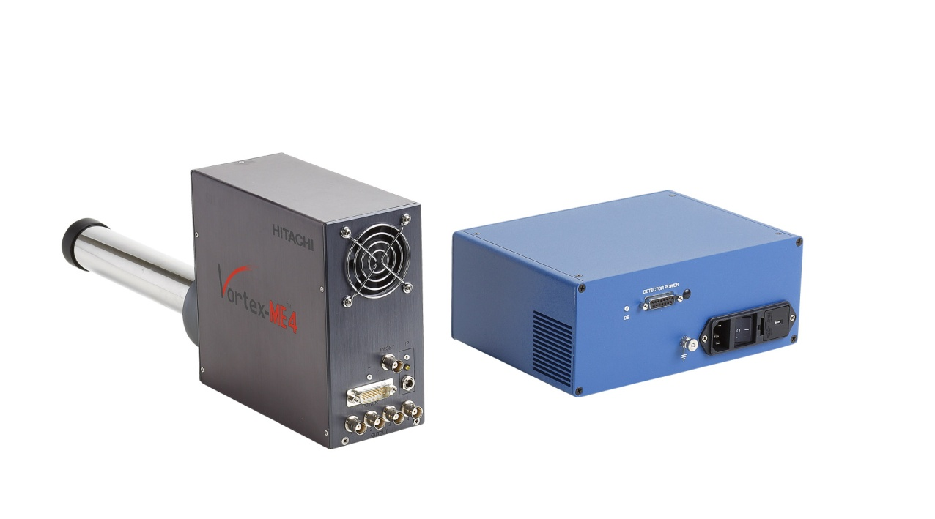
Measurements with the Vortex® ME-4 (4 element Array)

Slide 28
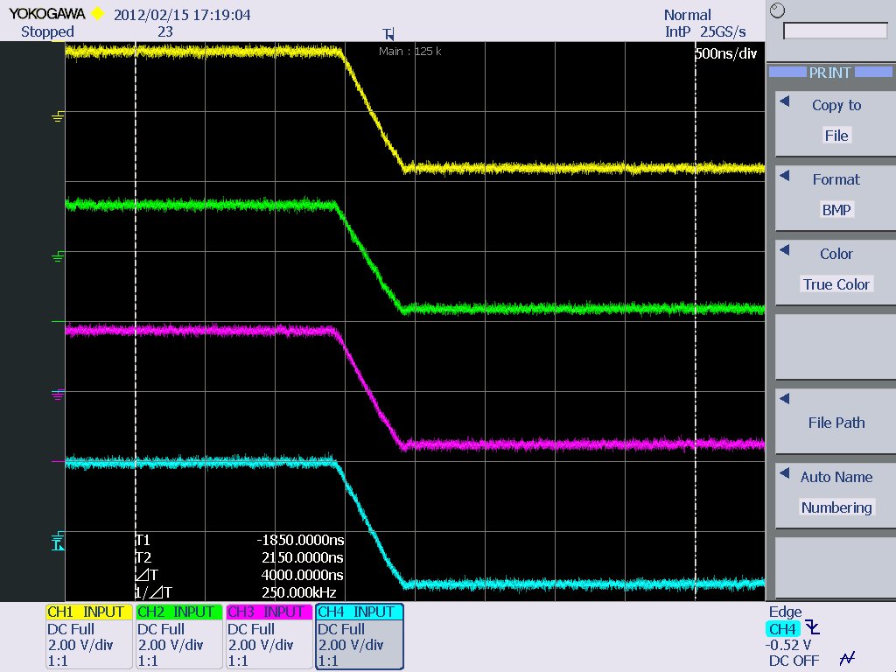
To prevent cross-talk between channels, a synchronized resent is applied

Slide 29
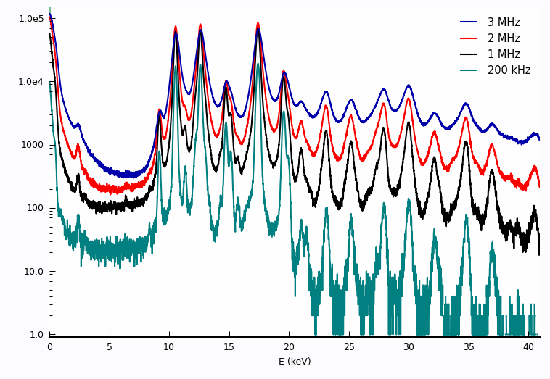
Vortex® ME-4 with Xspress3 Tests
PbMoO₄: Vortex 1mm thick Asic, not DTC, 3 MHz, 2 MHz, 1 MHz, 200 kHz spectra
A Vortex ME-4 (1 mm thick SDDs) was evaluated with the “Xspress3” at the Advance Photon Source (APS) at the Argonne National Laboratories, analyzing a sample (PbMoO₄) with multi-characteristic x-ray peaks at en extremely high count rate.
Even at 3 MHz the spectra are useful, if somewhat broadened. At 1 MHz, peaks are pretty well resolved.

Slide 30
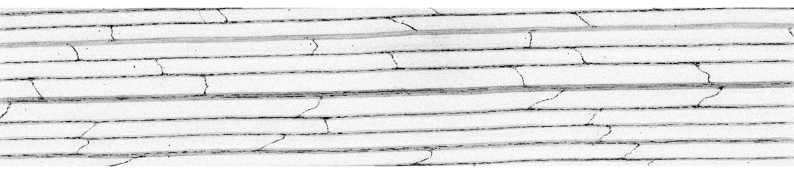
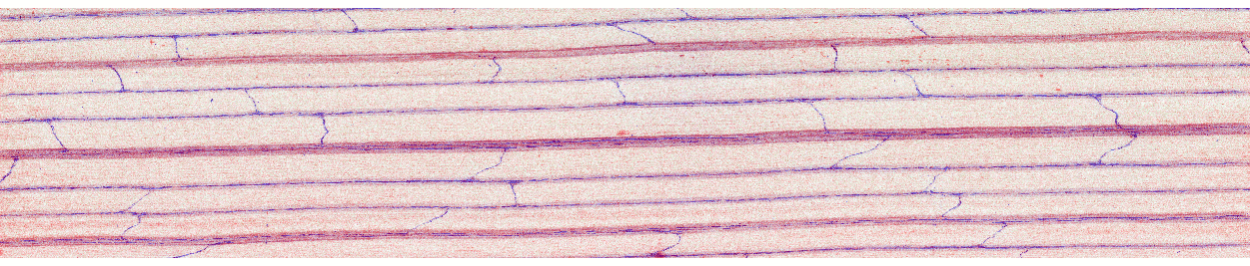
Vortex® ME-4 with Xspress3 Maps
Zn uptake in wheat: XRF map of Zn in wheat grass (Enzo Lombi, S. Australia, et al)
15 mm x 3 mm, mapped at 10 micron resolution, 10 msec per pixel. 3.5 hours
Zn
Mn (red), Zn (blue)

Slide 31
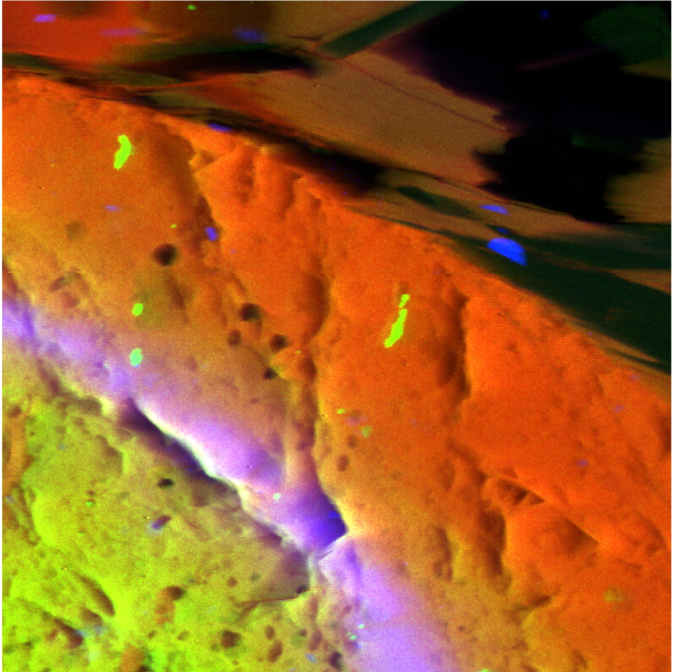
XRF Mapping with Xspress3 and Vortex® ME-4
Data collected at GSECARS, APS 13-ID-E with ~2 x 2 micron X-ray beam at 18 keV.
1 x 1 mm area, 2 x 2 μm pixels, 10 ms per pixel (~45 minute acquisition).
Sample: polished thin section of garnet with zoning in yttrium (the purple band).
Fe / Ca / Y

Slide 32
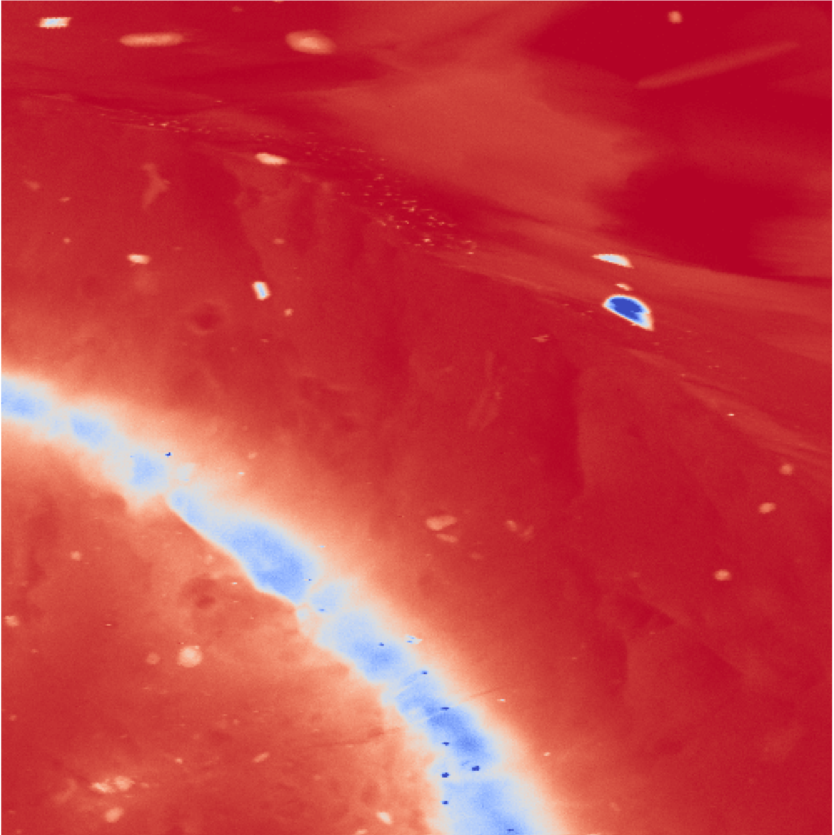

XRF Mapping with Xspress3 and Vortex ME-4
sample–detector distance ~ 40 mm for Xspress3, 65 mm for other advanced spectrometer (to avoid saturation)
Y intensity map (blue = high intensity)
Signal-to-noise and image contrast are noticeably improved with Xspress3.

Slide 33
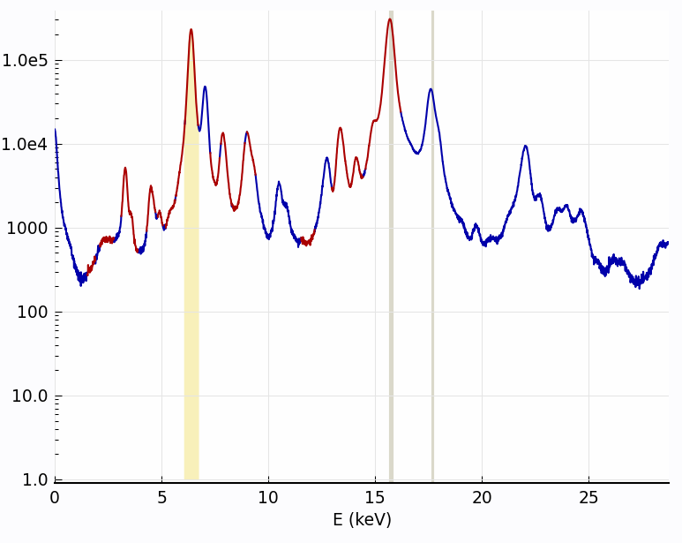
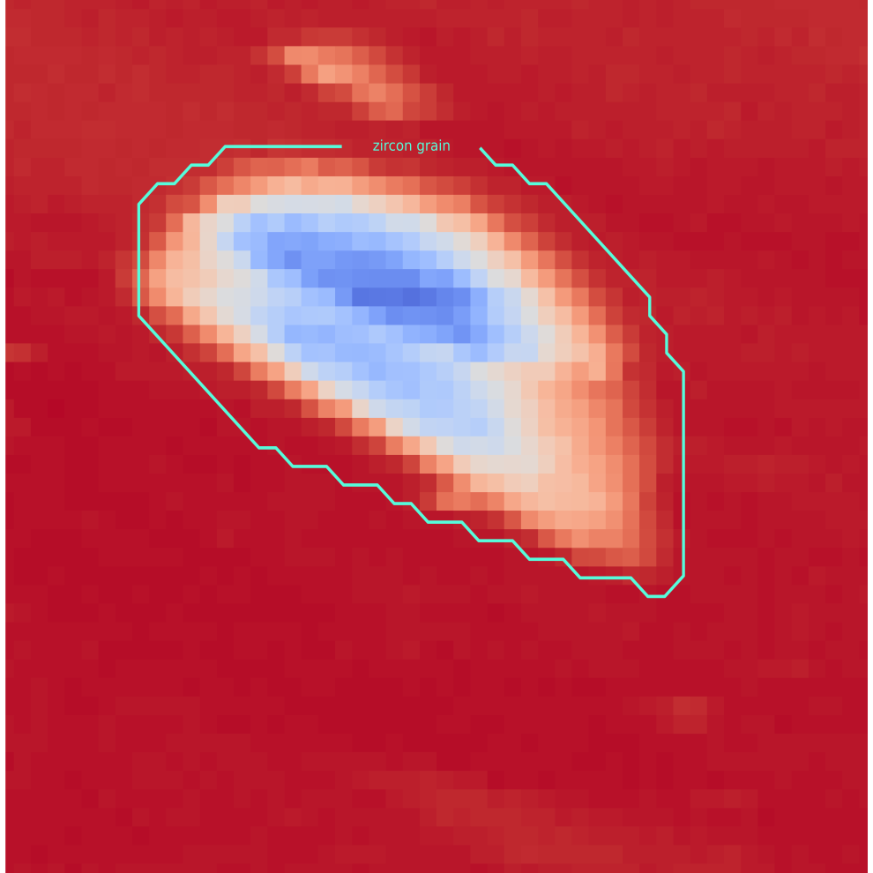
XRF Mapping with Xspress3 and Vortex® ME-4
Saturation effects: Xspress3 Y intensity map (blue = high intensity)
At very high count rate the Xspress3 shows some peak broadening,
but no obvious problems in the image.
Y map detail: zircon grain
XRF extracted from zircon grain (574 pixels, 5.7 sec). Count rates (sum of 4 elements, DT corrected):
5.538 MHz total, 1.083 MHz Fe Ka, 2.194 MHz Zr Ka
Xspress3

Slide 34
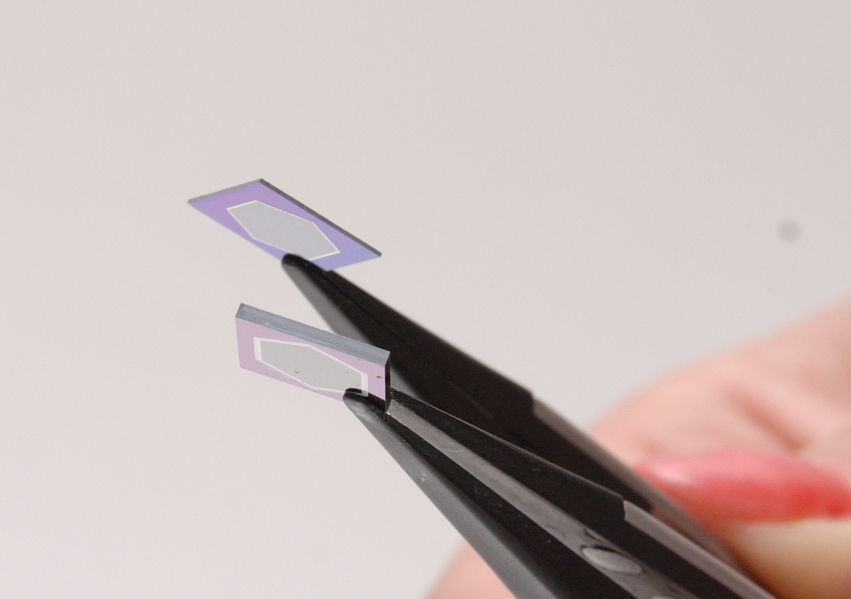
1mm Thick Silicon Drift Detector

Slide 37
32 keV B_{a} spectra from USGS GSP1 – Rh tube,
50 kV, 1 mA, 0.5 mm Cu + 6 mm Al Filter,
0.5 μs peaking time, 300 sec. live-time.

Slide 38
Pure Cd spectra acquired using a Rh tube, 40 kV, 0.052 mA; XIA Saturn DXP,
1 µs peaking time; 60 sec. live time.
The ratios of the net peak areas are:
1 : 0.75 : 0.56 for the 1, 0.5 and 0.35 mm SDDs, respectively.

Slide 39
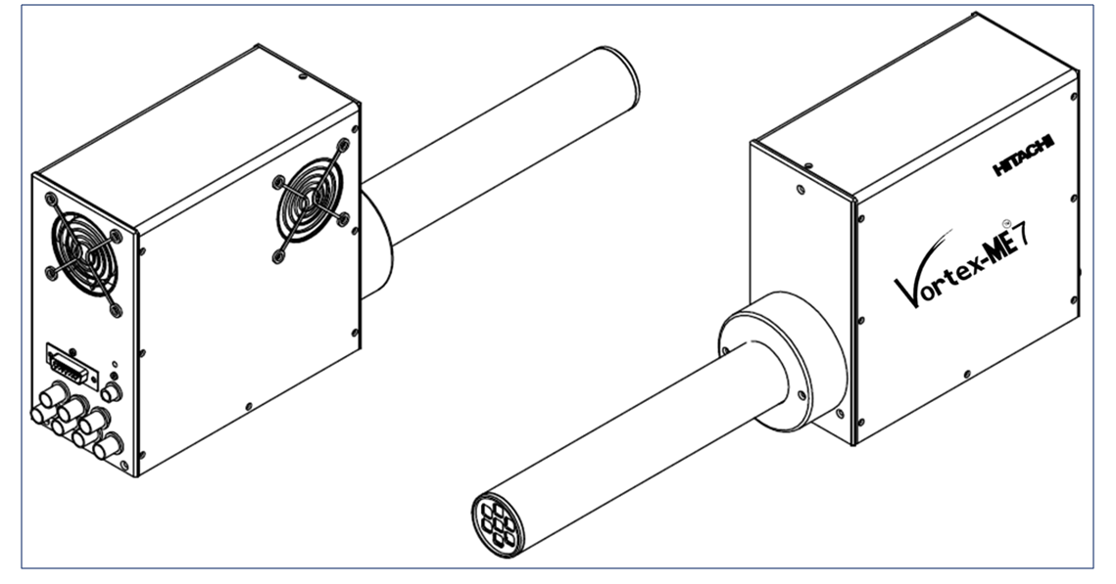
ME-7

Slide 40
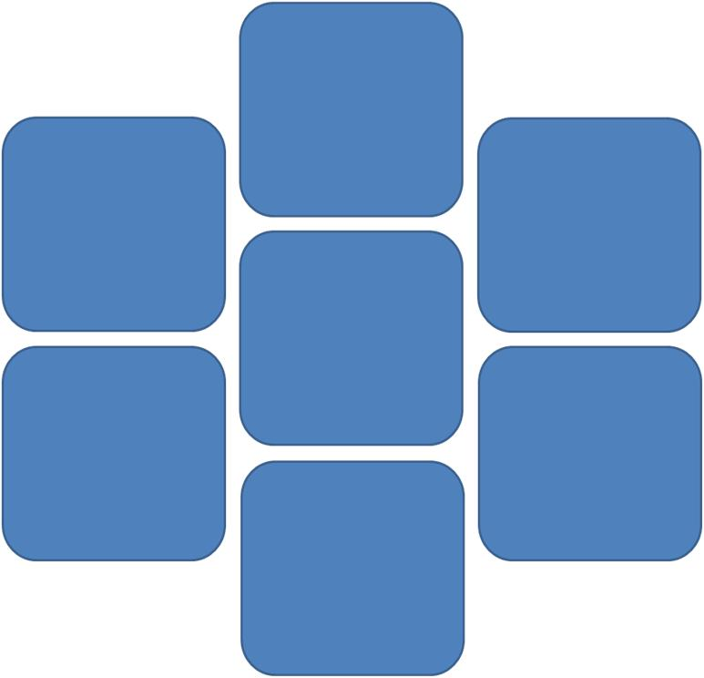
Layout of the 7 SDDs array
Best “packing factor”
SDD active area of each element 50 mm²
1.5” Tube Dia.
(38.1 mm)

Slide 41
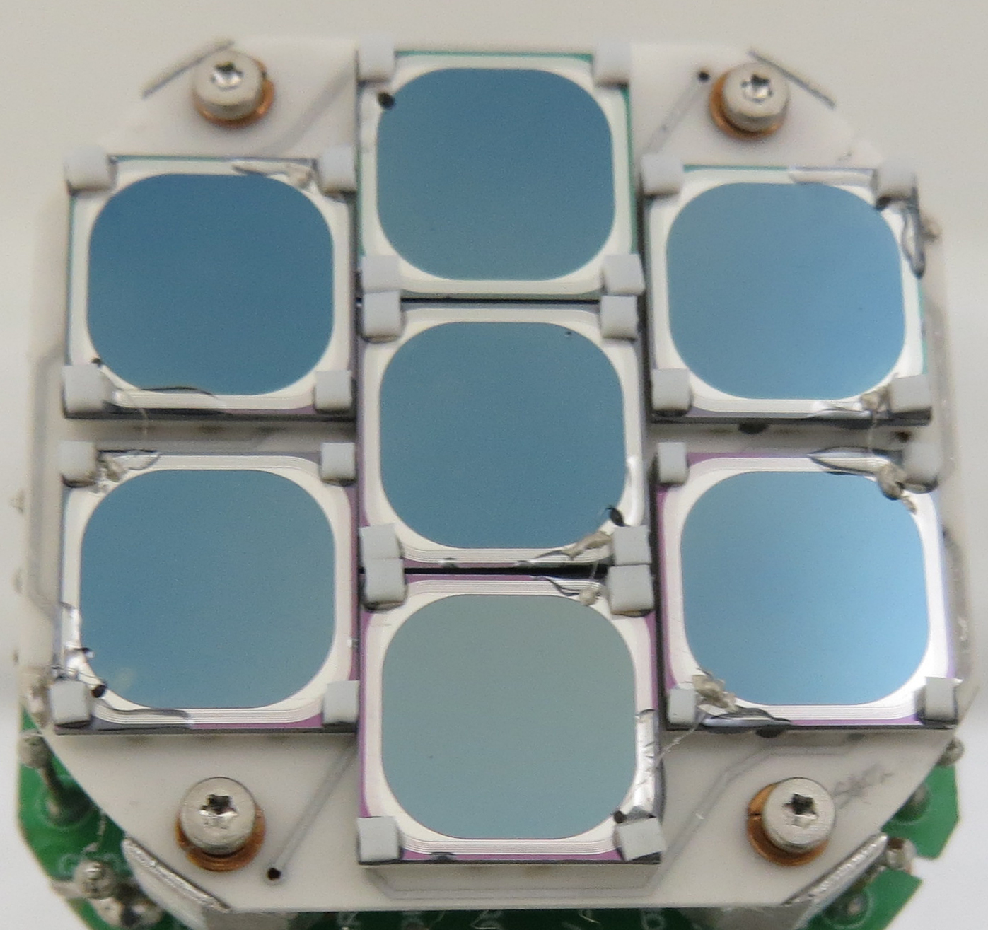

Slide 42
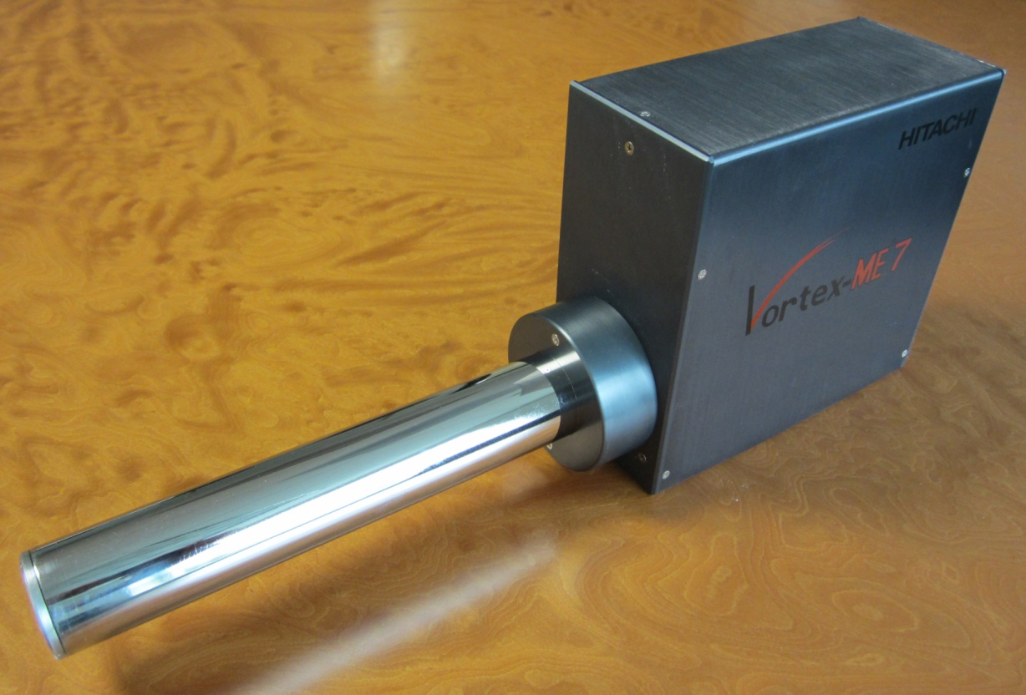
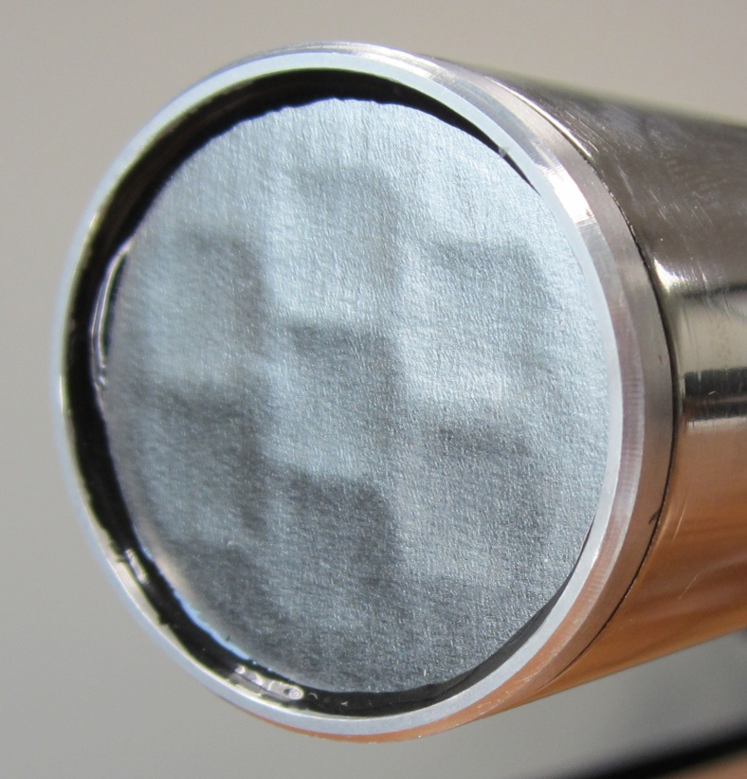
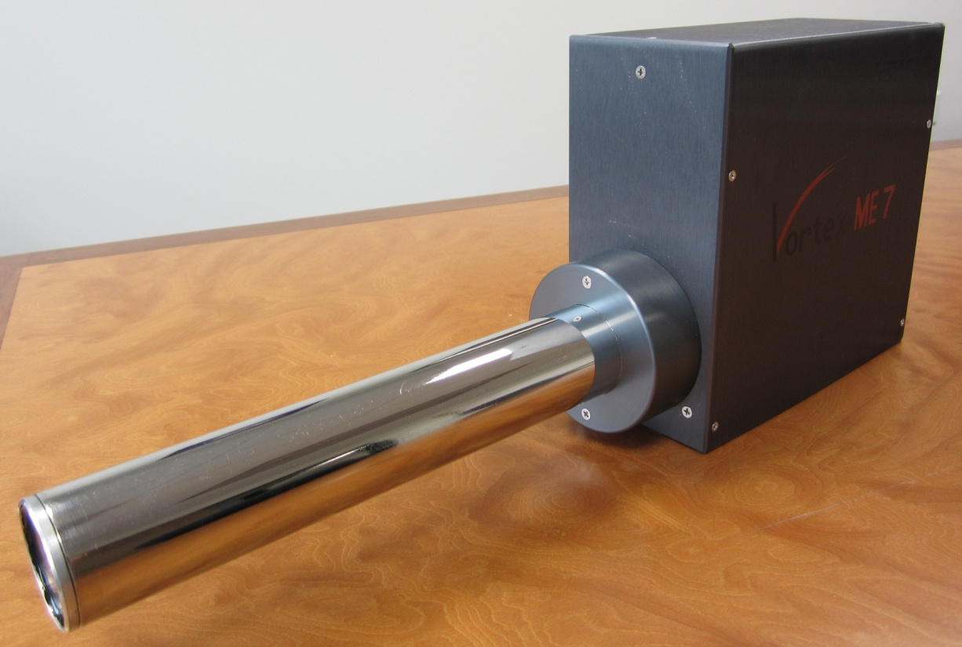
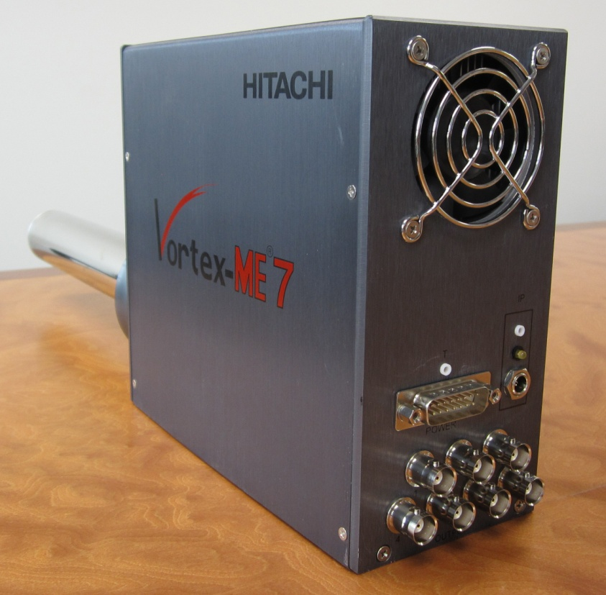

Slide 43
Thank You!
Contact Information:
Shaul Barkan shaul.barkan@hitachi-hitec-scuence.us
Tel: +1 (818) 470 7350

